Slide 1
Prediction Module for Social Media
Ananya Gupta, Jada Morrison, Stephone Jeffcoat, Jalena Jones
Date: 04/15/19

Slide 2
Classification Selection:
Personal interest/hobbies
Athletics
Cosmetics
Animal Lovers
Reading
Outgoing

Slide 3
Why is it interesting?
Best way to find friends with similar interests
To know more about new friend
Interest has several sub-groups which help to make better prediction
Includes varieties of Facebook users

Slide 4
Features:
Gender
Male
Female
Ethnicity
Caucasian
Asian
Minority
Relative
Yes
No
Age
18-25
26-35
36-55
Interests
Athletics
Cosmetics
Animal Lovers
Reading
Outgoing
Relationship
Yes
No
Post
Text
Image

Slide 5
Why is it important?
All of the features provide enough information if we want to be friend or not

Slide 6
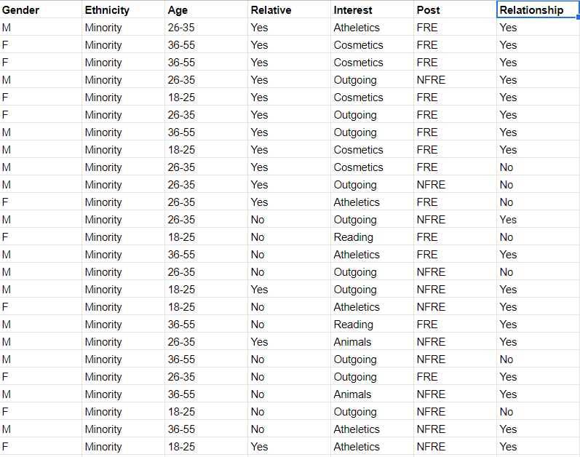
Sample table
of dataset:

Slide 7
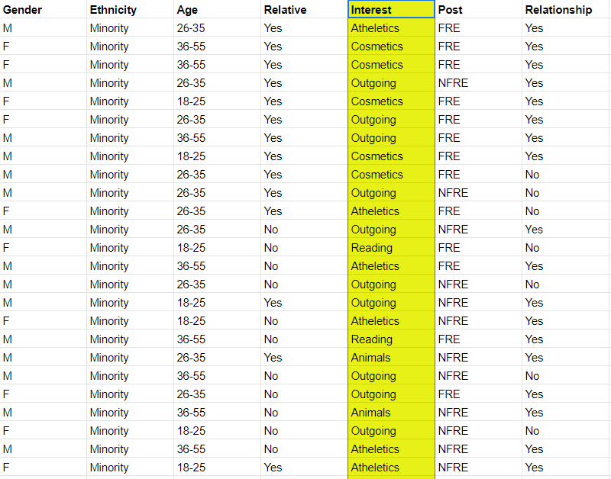
Classifying
dataset:

Slide 8
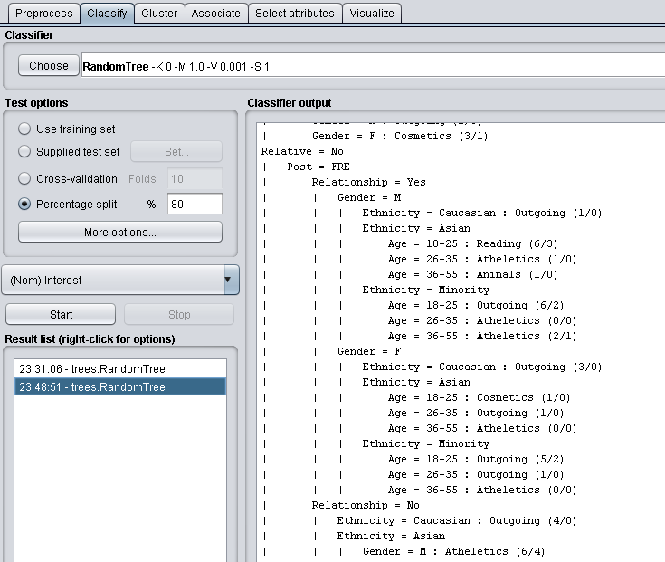
Decision Tree Sample
With the use of the Random Tree Classifier a Decision Tree is showcasing that most people tend to be outgoing over any other Hobbies that were provided within our dataset from Facebook.

Slide 9
Rules
Our Decision Tree’s rules are based on the Age, Gender, Hobbies, Post frequency and relation to new friends.
The most frequent hobbies from the decision tree were Outgoing and Athletics.

Slide 10
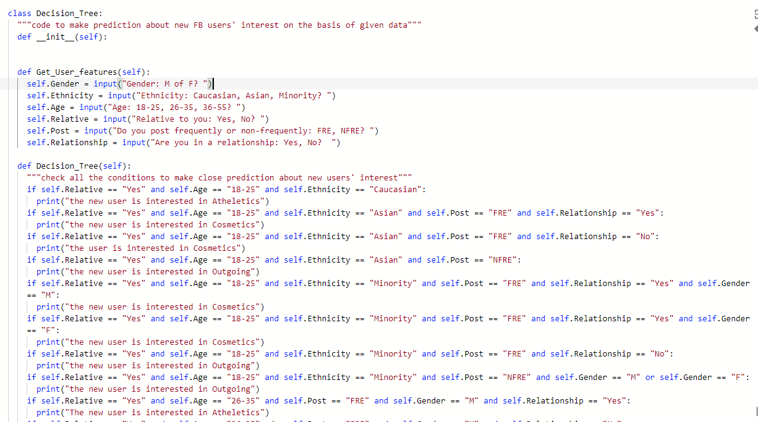
Python Code/Algorithm:

Slide 11
Confusion Matrix
 | Outgoing | Athletics | Reading | Animal Lovers | Cosmetics
Outgoing | 0.63 | 0.13 | 0 | 0 | 0.06
Athletics | 0.13 | 0.05 | 0 | 0 | 0.03
Reading | 0 | 0 | 0 | 0 | 0
Animal Lover | 0 | 0 | 0 | 0 | 0
Cosmetics | 0.06 | 0.03 | 0 | 0 | 0.03

Slide 12
Conclusion:
The efficiency of our prediction was 50% whereas it should be of at least more than 80% for highly efficient prediction module

